Slide 1
Lecture 21

Slide 2
5 maze functions in 2+ lectures (+ 2 more for later)
result | Non-functional requirement | sr/tr | path? | visited? | tandem WLs | rsf
true or false | must terminate | sr
true or false | visit each pos only once | tr
first path | small mazes | sr
shortest path Combination chooses shortest path | small mazes | sr
first path length | large mazes | tr
shortest path | large mazes | tr
shortest path length | large mazes | tr
l21:
l22:
l23:

Slide 3

Tree of x,y positions moving through this maze
0, 0
1, 0
0, 1
1, 1
0, 2
2, 1
1, 2
At each step it is only possible to move right (x+1) or down (y+1). But sometimes those may be invalid because they run into a wall or off the edge of the maze.
Do not assume each position can have only one valid next position. In general it is an arbitrary-arity tree.
…
This maze is solveable, so will eventually reach 4, 4. Yay!

Slide 4
(define M4
(list O O O O O
O W W W O
O W O O O
O W O W W
W W O O O))
must move left
need to be able to move up down left right

Slide 5


Slide 6
(define M7
(list O O O O O O O O O O
W W O W W O W W W O
O O O W W O W O O O
O W O O W O W O W W
O W W O W W W O O O
O W W O O O W W W O
O W W O W O W O O O
O W W O O O W O W W
O O O O W W W O O O
W W W W W O O W W O))

Slide 7
(define M7
(list O O O O O O O O O O
W W O W W O W W W O
O O O W W O W O O O
O W O O W O W O W W
O W W O W W W O O O
O W W O O O W W W O
O W W O W O W O O O
O W W O O O W O W W
O O O O W W W O O O
W W W W W O O W W O))
represent path to current position
use a path accumulator
fail when a cycle is detected
cycle

Slide 8
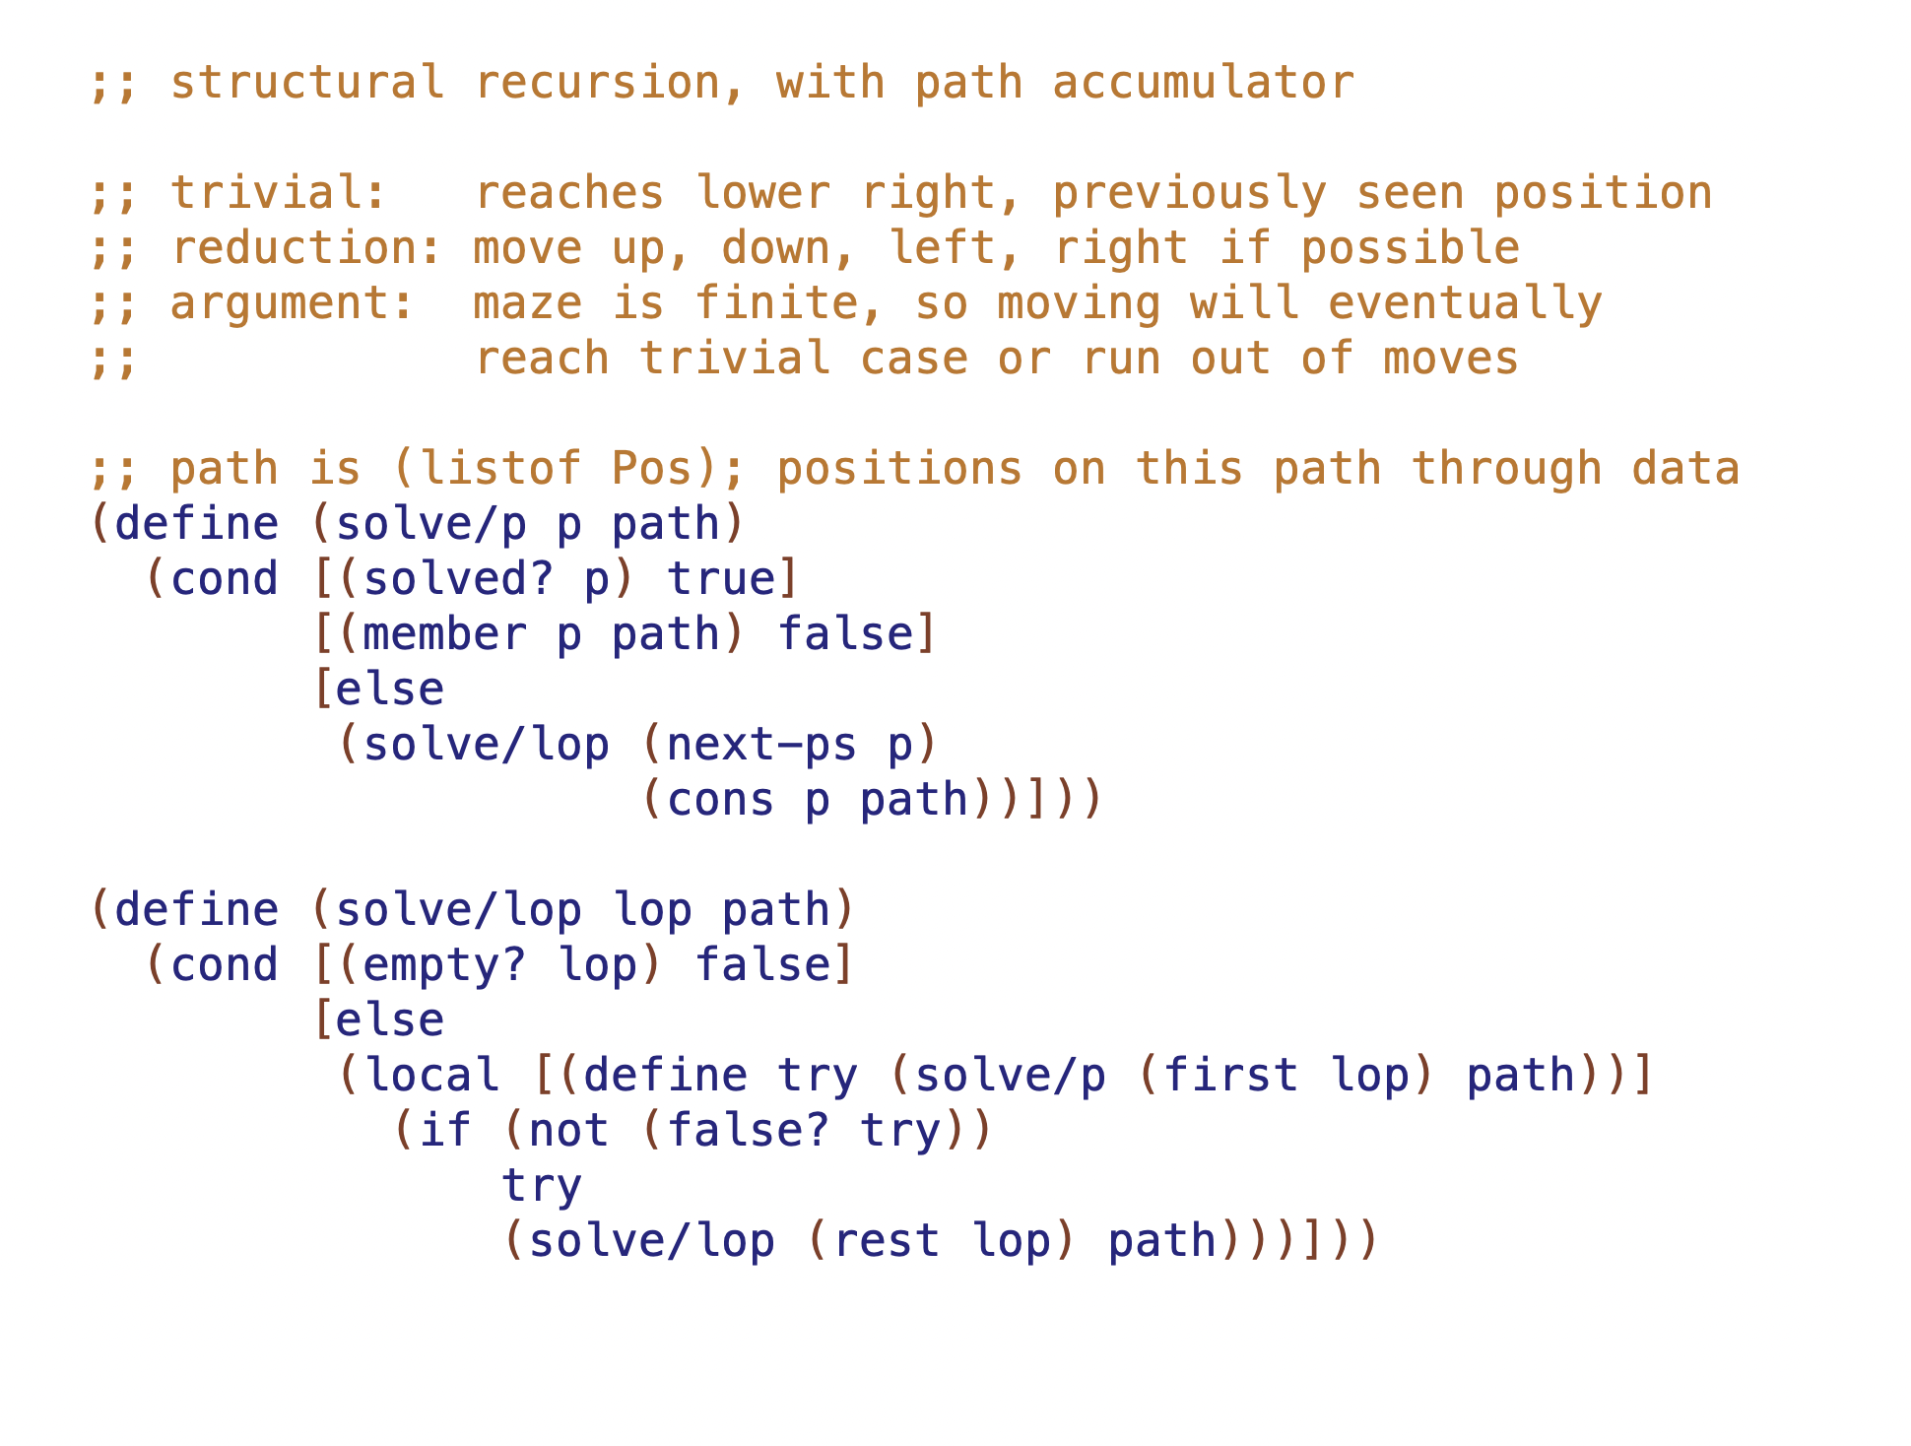

Slide 9
(define M7
(list O O O O O O O O O O
W W O W W O W W W O
O O O W W O W O O O
O W O O W O W O W W
O W W O W W W O O O
O W W O O O W W W O
O W W O W O W O O O
O W W O O O W O W W
O O O O W W W O O O
W W W W W O O W W O))
Period 1 – up to cycle detection

Slide 10
(define M7
(list O O O O O O O O O O
W W O W W O W W W O
O O O W W O W O O O
O W O O W O W O W W
O W W O W W W O O O
O W W O O O W W W O
O W W O W O W O O O
O W W O O O W O W W
O O O O W W W O O O
W W W W W O O W W O))
Period 2 –
backtrack
(grey is visited, but not path; there is grey under the red)

Slide 11
(define M7
(list O O O O O O O O O O
W W O W W O W W W O
O O O W W O W O O O
O W O O W O W O W W
O W W O W W W O O O
O W W O O O W W W O
O W W O W O W O O O
O W W O O O W O W W
O O O O W W W O O O
W W W W W O O W W O))
Period 3 – right branch and follow until detect cycle

Slide 12
(define M7
(list O O O O O O O O O O
W W O W W O W W W O
O O O W W O W O O O
O W O O W O W O W W
O W W O W W W O O O
O W W O O O W W W O
O W W O W O W O O O
O W W O O O W O W W
O O O O W W W O O O
W W W W W O O W W O))
Period 4 – right branch and immediately hit join

Slide 13
Directed Graphs
B
A
D
E
join
cycle
C

Slide 14
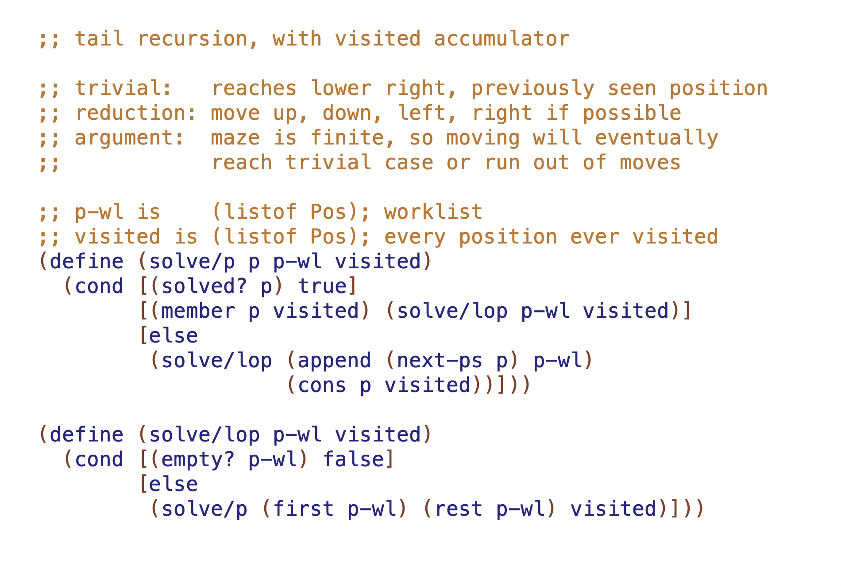

Slide 15
5 maze functions in 2 days (+ 2 more for later)
result | Non-functional requirement | sr/tr | path? | visited? | tandem WLs | rsf
true or false | must terminate | sr | Y | n/a | n/a | n/a
true or false | visit each pos only once | tr | N | Y | N | N
first path | small mazes | sr
shortest path Combination chooses shortest path | small mazes | sr
first path length | large mazes | tr
shortest path | large mazes
shortest path length | large mazes
l21:
l22:
l23:

Slide 16
Lecture 22

Slide 17
5 maze functions in 2 days (+ 2 more for later)
result | Non-functional requirement | sr/tr | path? | visited? | tandem WLs | rsf
true or false | must terminate | sr | Y | n/a | n/a | n/a
true or false | visit each pos only once | tr | N | Y | N | N
first path | small mazes | sr
shortest path Combination chooses shortest path | small mazes | sr
first path length | large mazes | tr
shortest path | large mazes
shortest path length | large mazes
l21:
l22:
l23:

Slide 18
produce path (sr)
(define M7
(list O O O O O O O O O O
W W O W W O W W W O
O O O W W O W O O O
O W O O W O W O W W
O W W O W W W O O O
O W W O O O W W W O
O W W O W O W O O O
O W W O O O W O W W
O O O O W W W O O O
W W W W W O O W W O))

Slide 19
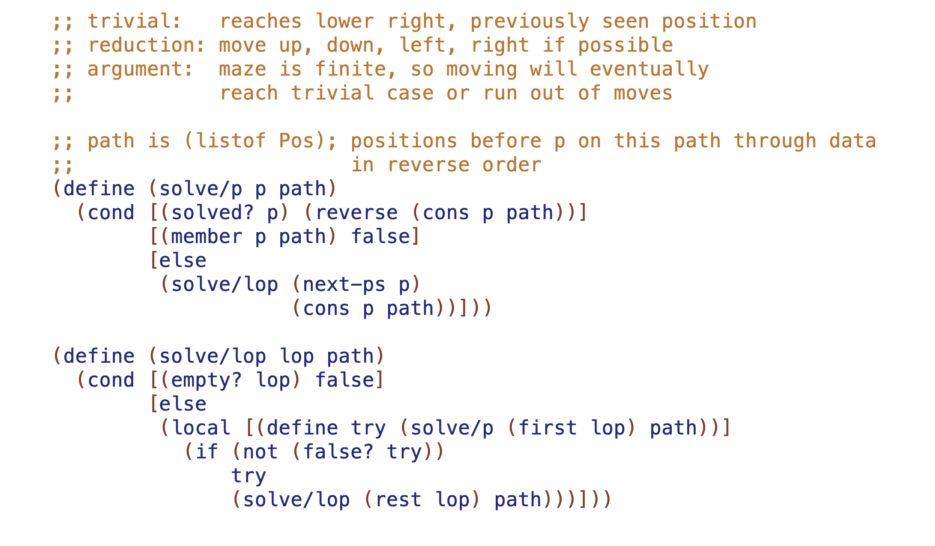

Slide 20
5 maze functions in 2 days (+ 2 more for later)
result | Non-functional requirement | sr/tr | path? | visited? | tandem WLs | rsf
true or false | must terminate | sr | Y | n/a | n/a | n/a
true or false | visit each pos only once | tr | N | Y | N | N
first path | small mazes | sr | Y | n/a | n/a | n/a
shortest path Combination chooses shortest path | small mazes | sr
first path length | large mazes | tr
shortest path | large mazes | tr
shortest path length | large mazes | tr
l21:
l22:
l23:

Slide 21
produce shortest path (sr)
(define M7
(list O O O O O O O O O O
W W O W W O W W W O
O O O W W O W O O O
O W O O W O W O W W
O W W O W W W O O O
O W W O O O W W W O
O W W O W O W O O O
O W W O O O W O W W
O O O O W W W O O O
W W W W W O O W W O))

Slide 22
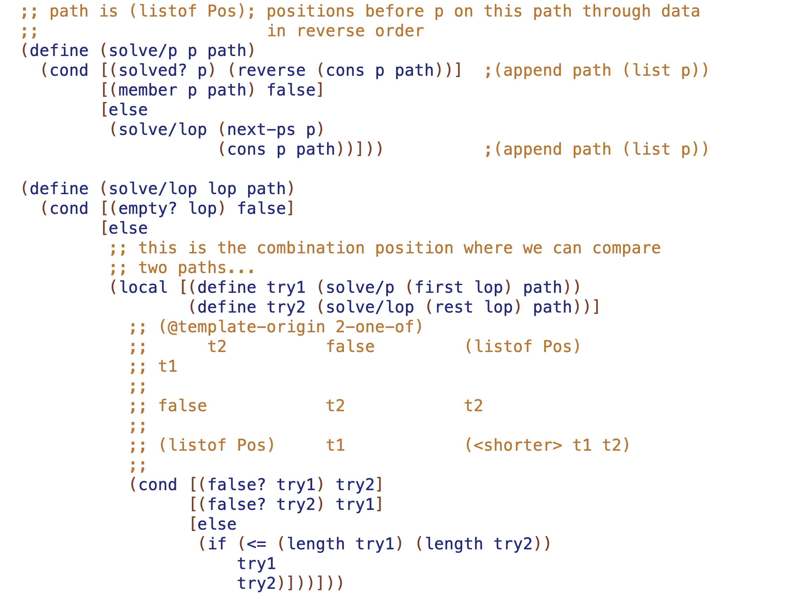

Slide 23
5 maze functions in 2 days (+ 2 more for later)
result | Non-functional requirement | sr/tr | path? | visited? | tandem WLs | rsf
true or false | must terminate | sr | Y | n/a | n/a | n/a
true or false | visit each pos only once | tr | N | Y | N | N
first path | small mazes | sr | Y | n/a | n/a | n/a
shortest path Combination chooses shortest path | small mazes | sr | Y | n/a | n/a | n/a
first path length | large mazes | tr
shortest path | large mazes | tr
shortest path length | large mazes | tr
l21:
l22:
l23:

Slide 24
first path length (tr)
(define M7
(list O O O O O O O O O O
W W O W W O W W W O
O O O W W O W O O O
O W O O W O W O W W
O W W O W W W O O O
O W W O O O W W W O
O W W O W O W O O O
O W W O O O W O W W
O O O O W W W O O O
W W W W W O O W W O))

Slide 25
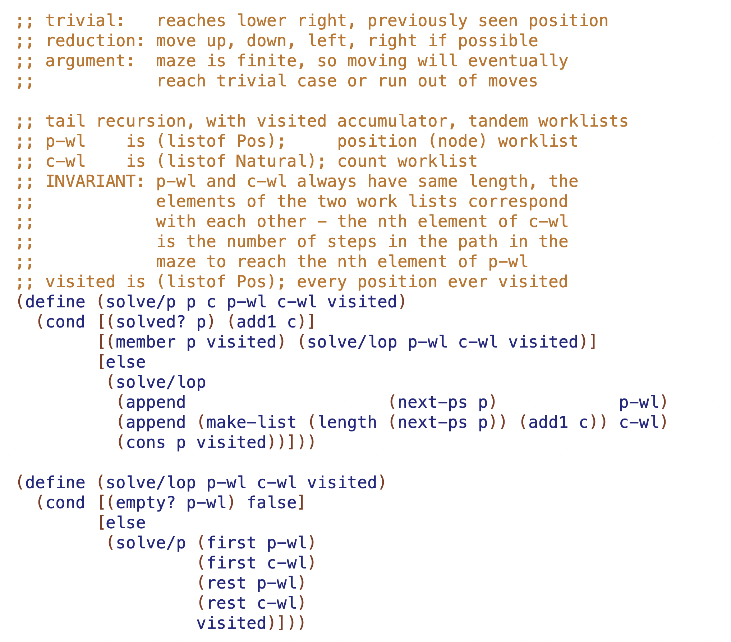

Slide 26
5 maze functions in 2 days (+ 2 more for later)
result | Non-functional requirement | sr/tr | path? | visited? | tandem WLs | rsf
true or false | must terminate | sr | Y | n/a | n/a | n/a
true or false | visit each pos only once | tr | N | Y | N | N
first path | small mazes | sr | Y | n/p | n/a | = path
shortest path Combination chooses shortest path | small mazes | sr | Y | n/p | n/a | N
first path length | large mazes | tr | N | Y | Y, path length | N
shortest path | large mazes | tr
shortest path length | large mazes | tr
l21:
l22:
l23:

Slide 27
Lecture 23

Slide 28
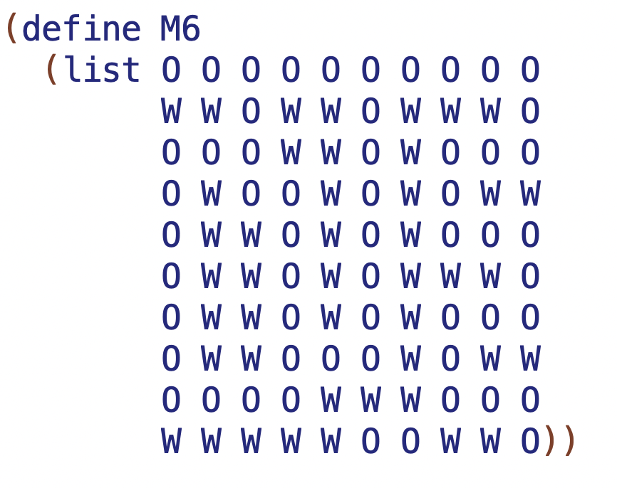

Slide 31
